Slide 1

PROJECT ID 24CC3046-P012
T114
Azure SQL Database with Failover Group and Private Endpoint
E-Commerce Order Management System
Team members
ID numbers
Koritala Bhavana
Devabhaktuni Monika Mithra
Kagitha prem Siddhartha
Balaga Harshavardhan Naidu
2400030596
2400031564
2400031606
2400031652
Secure, highly available cloud database architecture for critical order processing.

Slide 2
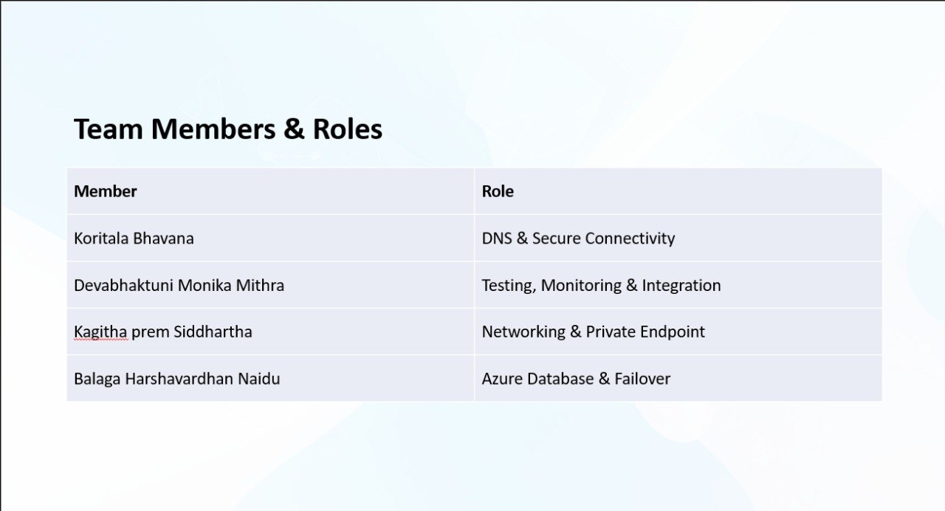

Slide 3
Problem Statement
E-commerce platforms depend on continuous database availability for critical operations such as checkout and order processing. A regional Azure failure can make the database unavailable and interrupt these operations, while public database access introduces security risks. The challenge is to provide secure private database access and cross-region availability while allowing the application to continue operating during database failover.

Slide 4
Use Cases
Secure Database Access
High Availability
Application Continuity
No direct public access
Private Endpoint + Private DNS
Primary database in Region 1
Secondary database in Region 2
Failover during regional failure
Application uses Failover Group Listener
Same endpoint after failover
No connection-string change

Slide 5
Azure Services
Core Azure services used in the proposed secure and highly available architecture.
1
Azure SQL Database — Primary
2
Azure SQL Database — Secondary
3
Azure SQL Failover Group
4
Azure Virtual Network (VNet)
5
Subnets
6
Private Endpoint — Primary
7
Private Endpoint — Secondary
8
Private DNS Zone
9
Network Security Group (NSG)
10
Route Table
11
Azure VM — Testing
Secure • Private • Highly Available

Slide 6

Bottlenecks
Proactive identification and mitigation of these critical issues are essential for maintaining continuous database availability and secure operations.
Bottleneck 1 — Private Endpoint DNS
Bottleneck 2 — Failover Group Listener
SQL hostname must resolve to the private endpoint
Incorrect DNS → database connection failure
Direct connection to primary can cause issues after failover
Application should use the Failover Group read/write listener

Slide 7
Layered Architecture for Database Resilience
Our proposed solution builds a robust and secure database architecture by layering key Azure services, ensuring both data protection and continuous availability.
Cross-Region Replication
Private DNS
Provides geographical redundancy and cross-region database availability for disaster recovery.
Private Endpoint
Resolves the SQL hostname to the private endpoint, securing all database traffic.
Enables private database connectivity, ensuring public network access is disabled.
Secure + Highly Available Database
Azure SQL Failover Group
Combines private connectivity, secure DNS, and cross-region replication to protect data and maintain database availability during failures.
Orchestrates failover and ensures a stable application endpoint, preventing connection string changes during outages.

Slide 8
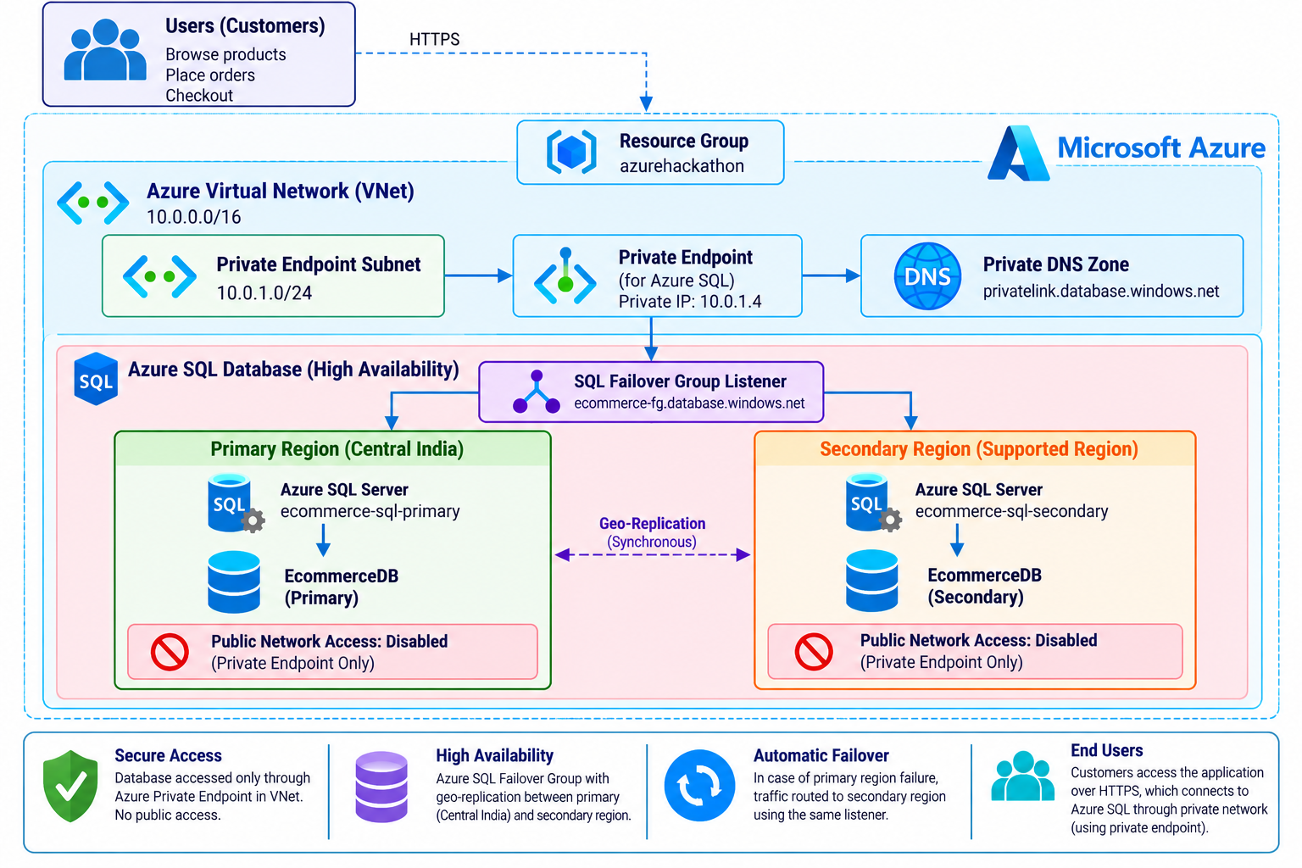
Architecture Diagram

Slide 9
Expected Outcome
Secure Private Database Access
Cross-Region Availability
No direct public network access, protecting sensitive data.
Ensuring continuous operation even during regional failures.
Seamless Database Failover
Application Continuity
Automated switching to secondary database with minimal disruption.
Applications remain connected without manual intervention.
No Public Database Exposure
Reliable DNS Resolution
Eliminating external access points for enhanced security.
Consistent hostname resolution for stable connectivity.
Our goal is to keep the e-commerce database secure and available even when the primary Azure region fails.

